Slide 1


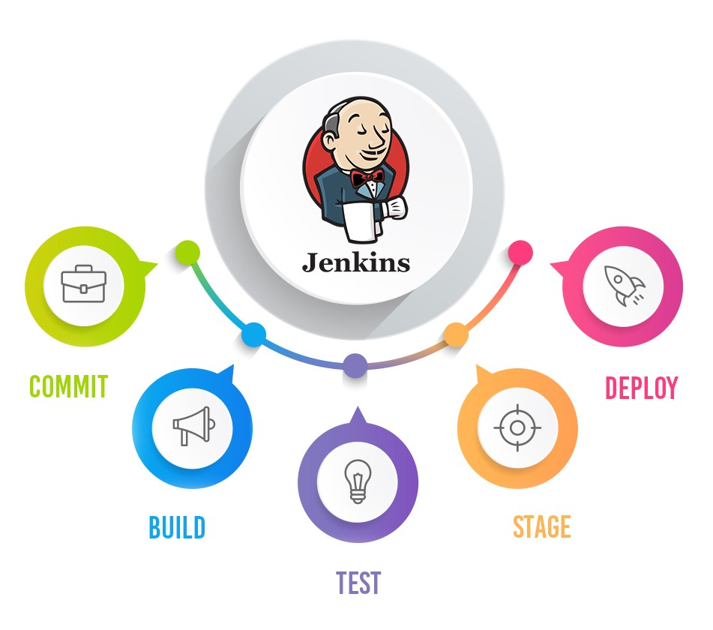
Jenkins Mastery for Software Tester
Pramod Dutta
Master Slave in Jenkins

Slide 2

Master Slave in Jenkins
Avoid Running Builds on the Same Jenkins Master Machine.
You can add Slave Machines which can be on cloud, local extra
You need to open the In bound 8090 Port in Security and Network Group.
Same JRE on Master, Slave

Slide 3
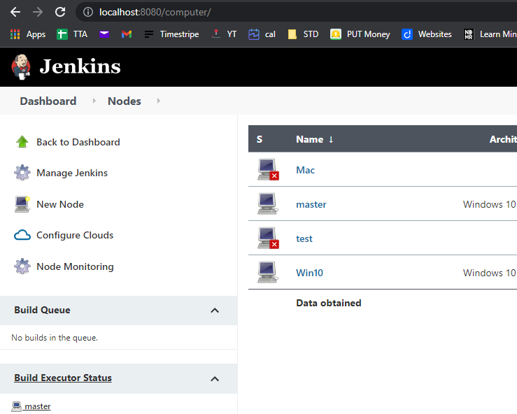
Go To Nodes and Add the Slave

Slide 4
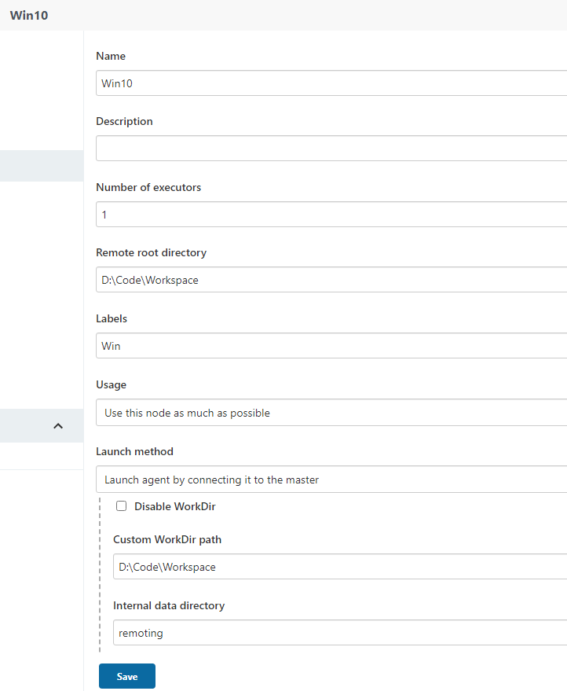
Go To Nodes and Add the Slave

Slide 5
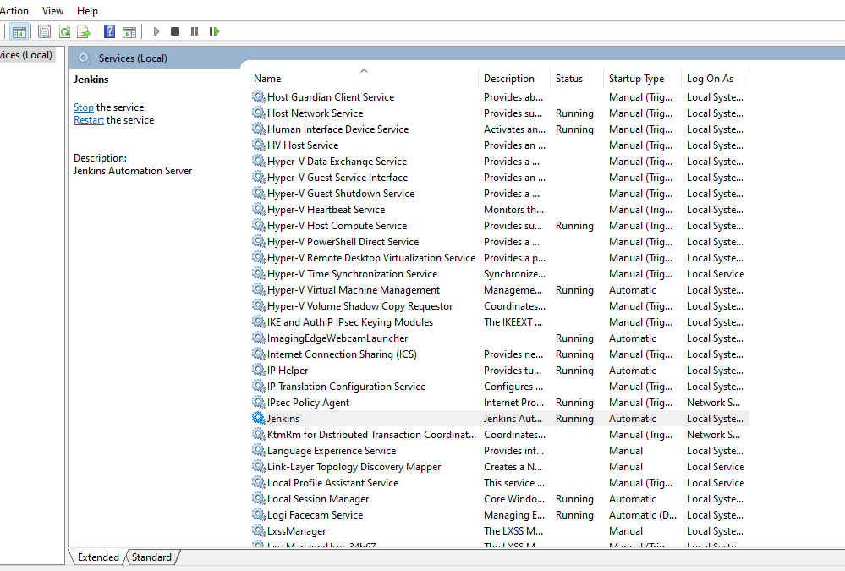
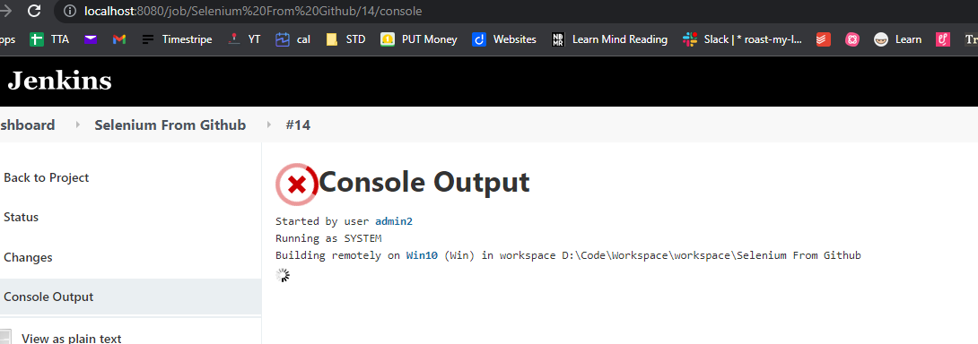
Go To Nodes and Add the Slave
For Windows, go to Services (Start → Run: services.msc), find Jenkins and Jenkins Agent, right click → Restart.

